Slide 1
Urinary Tract Infections
(adult): Empirical Treatment
Dr. pershang nazemi
Assistant professor of infectious diseases
Tum.yas hospital

Slide 2
introduction
common in the hospital and community setting.
the fourth most common indication for prescribing antimicrobials in hospital
responsible for a large number of presentations in general practice and frequent antibiotic prescriptions
More than 30% of women will experience a UTI during their lifetime

Slide 3
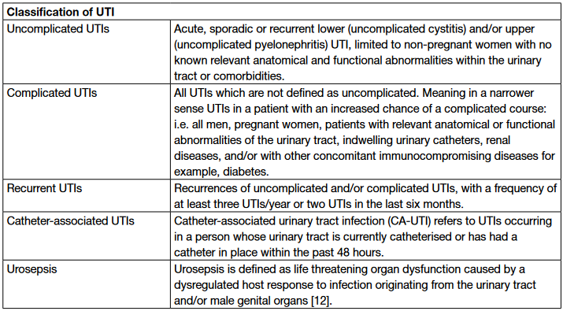

Slide 4
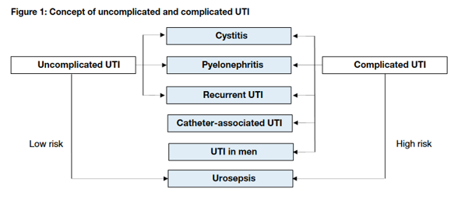

Slide 5
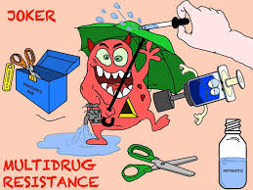
Attention please!!!
There is a clear association between antibiotic prescribing in suspected UTI and the development of
antimicrobial resistance (AMR)

Slide 6

DIAGNOSIS:
A detailed patient history is important to
inform a differential diagnosis and exclude other causes (e.g., a sexually transmitted infection that may present with urinary symptoms alone).

Slide 7

Microscopy, culture, and antibiotic sensitivity analysis of a mid-stream clean-catch urine specimen is the
gold standard diagnostic test for all suspected symptomatic UTI.
Contamination should be considered for urine specimens with:
1. Greater than 20 epithelial cells with no signs or symptoms; OR
2. Bacteria but no leucocytes; OR
3. Growth of multiple organisms (with or without leukocytosis).

Slide 8
Staphylococcus aureus is an unusual cause of bacteriuria in the absence of catheterization or instrumentation.
This culture may therefore be indicative of S. aureus bacteremia.
Blood cultures and consultation with Infectious Diseases (ID)/Microbiology may be indicated.

Slide 9

Asymyomatic baceriuria
urinary growth of bacteria in an asymptomatic individual (asymptomatic bacteriuria - ABU) is common, and
corresponds to a commensal colonization
Clinical studies have shown that ABU may protect against superinfecting symptomatic UTI, thus treatment of ABU should be performed only in cases of proven benefit
for the patient to avoid the risk of selecting antimicrobial resistance and eradicating a potentially protective
ABU strain

Slide 10
in an individual without urinary tract symptoms is defined by a mid-stream sample of urine showing bacterial growth > 10 5 cfu/mL in two consecutive
samples in women
In a single catheterized sample, bacterial growth may be as low as 10 2 cfu/mL to be considered representing true bacteriuria in both men and women
Cystoscopy and/or imaging of the upper urinary tract is not mandatory if the medical history is otherwise without remark.
If persistent growth of urease producing bacteria, i.e. Proteus mirabilis is detected, stone formation in the urinary tract must be excluded

Slide 11

Asymptomatic bacteriuria does not cause renal disease or damage
Only one prospective, non-randomised
study investigated the effect of treatment of ABU in adult, non-diabetic, non-pregnant women
and found no difference in the rate of symptomatic UTIs.
screening and treatment of ABU is not
recommended in patients without risk factors

Slide 12
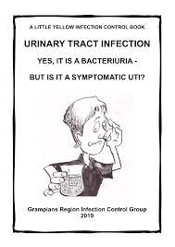
Treatment of asymptomatic bacteriuria is not beneficial in the following conditions:
• women without risk factors;
• patients with well-regulated diabetes mellitus;
• post-menopausal women;
• elderly institutionalized patients;
• patients with dysfunctional and/or reconstructed lower urinary tracts;
• patients with renal transplants;
• patients prior to arthroplasty surgeries.

Slide 13

Treatment of asymptomatic bacteriuria is harmful in patients with recurrent urinary tract infections.
Screen for and treat asymptomatic bacteriuria in pregnant women with standard short
course treatment
Do not screen or treat asymptomatic bacteriuria in the following conditions:
• women without risk factors;
• patients with well-regulated diabetes mellitus;
• post-menopausal women;
• elderly institutionalized patients;
• patients with dysfunctional and/or reconstructed lower urinary tracts;
• patients with renal transplants;
• patients prior to arthroplasty surgeries;
• patients with recurrent urinary tract infections. Screen for and treat asymptomatic bacteriuria prior to urological procedures breaching the

Slide 14
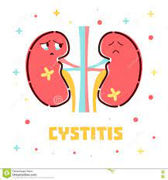
Uncomplicated cystitis
Clinical diagnosis
based on a focused history of lower urinary tract symptoms (dysuria, frequency and urgency) and the absence of vaginal discharge
In elderly women genitourinary symptoms are not necessarily related to cystitis
Laboratory diagnosis
In patients presenting with typical symptoms of an uncomplicated cystitis urine analysis (i.e. urine culture, dipstick testing, etc.) leads only to a minimal increase in diagnostic accuracy
Taking a urine culture is recommended in patients with atypical symptoms, as well as those who fail to respond to appropriate antimicrobial therapy

Slide 15

OPTIONS:
oral treatment with fosfomycin
trometamol 3 g single dose,
pivmecillinam 400 mg three times a day for three to five day nitrofurantoin
(e.g. nitrofurantoin monohydrate/microcrystals 100 mg twice daily for five days),
Co-trimoxazole (160/800 mg twice daily for three days) or trimethoprim (200 mg twice daily for five days)
should only be considered as drugs of first choice in areas with known resistance rates for E. coli of < 20%
Aminopenicillins are no longer suitable for empirical therapy because of worldwide high E. coli
resistance
. Aminopenicillins in combination with a beta-lactamase inhibitor such as ampicillin/sulbactam
or amoxicillin/clavulanic acid and oral cephalosporins are not recommended for empirical therapy
fluoroquinolone should only be used when it is considered inappropriate to use other antibacterial agents

Slide 16

Short courses of antimicrobial therapy can also be considered for treatment of cystitis in pregnancy
but not all antimicrobials are suitable during pregnancy.
penicillins,
cephalosporins,
fosfomycin,
nitrofurantoin (not in case of glucose-6-phosphate dehydrogenase deficiency and during the end of pregnancy),
trimethoprim (not in the first trimenon)
sulphonamides (not in the last trimenon),

Slide 17
Clinical success for the treatment of uncomplicated cystitis is significantly more likely in women treated with antimicrobials than placebo.
Aminopenicillins are no longer suitable for antimicrobial therapy in uncomplicated cystitis because of negative ecological effects, high resistance rates and their increased selection for extended spectrum
beta-lactamase (ESBL)-producing bacteria.
Prescribe fosfomycin trometamol, pivmecillinam or nitrofurantoin as first-line treatment for uncomplicated cystitis in women.
Do not use aminopenicillins or fluoroquinolones to treat uncomplicated cystitis.

Slide 18
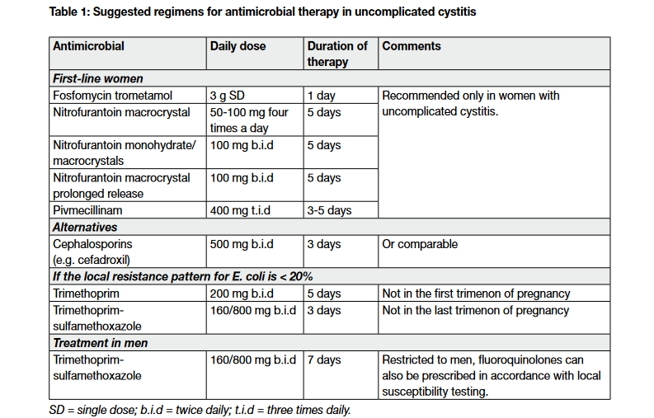

Slide 19
Follow-up
Routine post-treatment urinalysis or urine cultures in asymptomatic patients are not indicated
In women whose symptoms do not resolve by end of treatment, and in those whose symptoms resolve but recur within two weeks, urine culture and antimicrobial susceptibility testing should be performed
For therapy in this situation, one should assume that the infecting organism is not susceptible to the agent originally used.
Retreatment with a seven-day regimen using another agent should be considered

Slide 20
RECURRENT UTI
Recurrent UTIs (rUTIs) are recurrences of uncomplicated and/or complicated UTIs, with a frequency of at least three UTIs/year or two UTIs in the last six months.
Although rUTIs include both lower tract infection (cystitis) and upper tract infection (pyelonephritis), repeated pyelonephritis should prompt consideration of a
complicated a etiology.
Recurrent UTIs are common.
Diagnosis of rUTI should be confirmed by urine culture.
An extensive routine workup including cystoscopy, imaging, etc., is not routinely recommended as the diagnostic yield is low
it should be performed without delay in atypical cases, for example, if renal calculi, outflow obstruction, interstitial cystitis or urothelial cancer is suspected

Slide 21
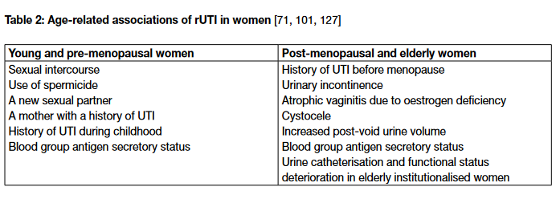

Slide 22
Disease management and follow_up
Prevention of rUTIs includes counselling regarding avoidance of risk factors, non-antimicrobial measures and
antimicrobial prophylaxis
These interventions should be attempted in this order. Any urological risk factor must be identified and treated.
Significant residual urine should be treated optimally, including by clean intermittent catheterization (CIC) when judged to be appropriate

Slide 23

Extensive routine workup including cystoscopy, imaging, etc., has a low diagnostic yield for the
diagnosis of rUTI.
Increased water intake is an effective antimicrobial-sparing strategy to prevent rUTI in pre-menopausal
women at high risk for recurrence who drink low volumes (< 1.5 L) of fluid daily.
Vaginal oestrogen replacement has shown a trend towards preventing rUTI in post-menopausal
Immunoactive prophylaxis has been shown to be more effective than placebo in female patients with
rUTIs in several RCTs with a good safety profile.
Probiotics containing L. rhamnosus GR-1, L. reuteri B-54 and RC-14, L. casei shirota, or L. crispatus
CTV-05 are effective for vaginal flora restoration and prevention of rUTIs.
Current scientific evidence regarding the efficacy of cranberry products in the prevention of UTIs is
divided.
Based on limited evidence, D-mannose can significantly reduce the number of UTI episodes and can be an effective agent for UTI prevention in selected patients.
Based

Slide 24

based on limited evidence intravesical GAG therapy can reduce the number of UTIs per patient per
year, and prolong the time interval between rUTI episode
Both continuous low-dose antimicrobial prophylaxis and post-coital antimicrobial prophylaxis, have
been shown to reduce the rate of rUTI.
A prospective cohort study showed that intermittent self-start therapy is effective, safe and
economical in women with rUTIs.
Recommendations Strength rating
Diagnose recurrent UTI by urine culture. Strong
Do not perform an extensive routine workup (e.g cystoscopy, full abdominal ultrasound) in
women younger than 40 years of age with recurrent UTI and no risk factors.
Advise pre-menopausal women regarding increased fluid intake as it might reduce the risk
of recurrent UTI.
Use vaginal oestrogen replacement in post-menopausal women to prevent recurrent UTI

Slide 25
Use immunoactive prophylaxis to reduce recurrent UTI in all age groups. Strong
Advise patients on the use of local or oral probiotics containing strains of proven efficacy for vaginal flora regeneration to prevent UTIs.
Advise patients on the use of cranberry products to reduce recurrent UTI episodes;
however, patients should be informed that the quality of evidence underpinning this is low with contradictory findings
Use D-mannose to reduce recurrent UTI episodes, but patients should be informed that further studies are needed to confirm the results of initial trials
Use endovesical instillations of hyaluronic acid or a combination of hyaluronic acid and chondroitin sulphate to prevent recurrent UTIs in patients where less invasive preventive approaches have been unsuccessful. Patients should be informed that further studies are needed to confirm the results of initial trials.
Use continuous or post-coital antimicrobial prophylaxis to prevent recurrent UTI when non-antimicrobial interventions have failed. Counsel patients regarding possible side effects.
For patients with good compliance self-administered short-term antimicrobial therapy should be considered

Slide 26
Uncomplicated pyelonephritis
Uncomplicated pyelonephritis is defined as pyelonephritis limited to non-pregnant, pre-menopausal women with no known relevant urological abnormalities or comorbidities.

Slide 27

Summary of evidence and recommendations for the diagnostic evaluation of uncomplicated pyelonephritis
Urine culture and antimicrobial susceptibility testing should be performed in all cases of pyelonephritis in addition to urinalysis.
A prospective observational cohort study found that radiologic imaging can selectively be applied in adults with febrile UTI without loss of clinically relevant information by using a simple clinical prediction rule.
Additional imaging investigations, such as a contrast enhanced CT scan should be done if the patient remains febrile after 72 hours of treatment or in patients with suspected complications e.g. sepsis

Slide 28

Recommendations:
Perform urinalysis (e.g. using the dipstick method), including the assessment of white and red blood cells and nitrite, for routine diagnosis.
Perform urine culture and antimicrobial susceptibility testing in patients with pyelonephritis.
Perform imaging of the urinary tract to exclude urgent urological disorders.

Slide 29
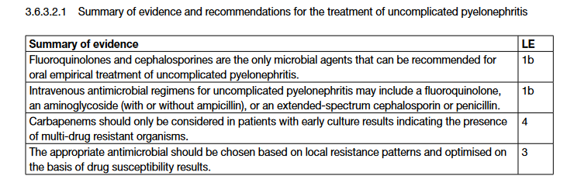
Disease management

Slide 30
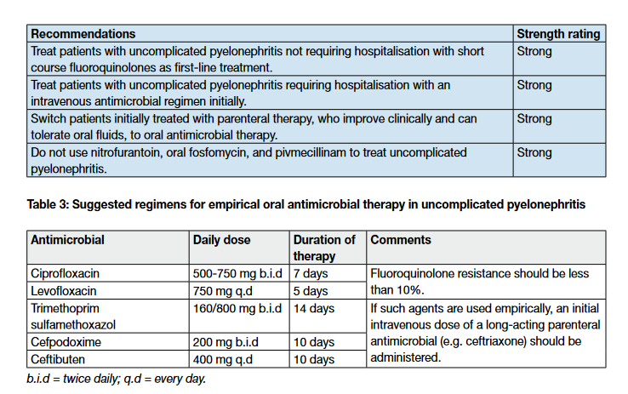

Slide 31
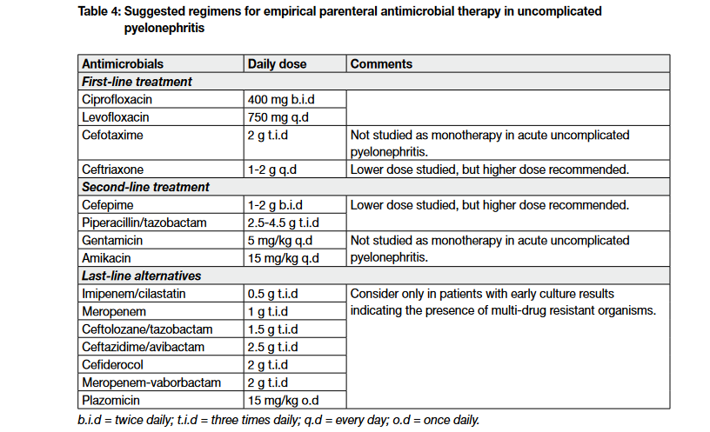

Slide 32

Note:
In pregnant women with pyelonephritis, outpatient management with appropriate parenteral antimicrobials may
also be considered, provided symptoms are mild and close follow-up is feasible In more severe cases of pyelonephritis, hospitalization and supportive care are usually required
. After clinical improvement parenteral therapy can also be switched to oral therapy for a total treatment duration of seven to ten days.
Follow-up Post-treatment urinalysis or urine cultures in asymptomatic patients post-therapy are not indicated

Slide 33
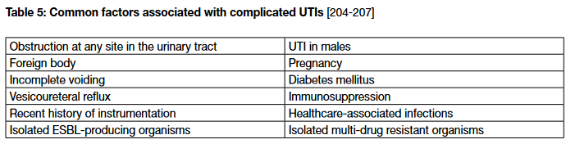
Complicated UTI

Slide 34
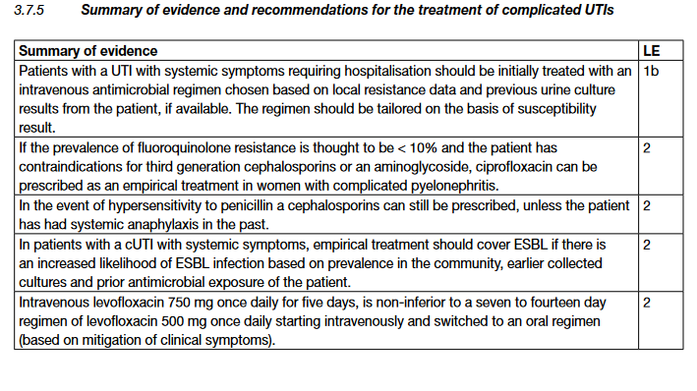

Slide 35
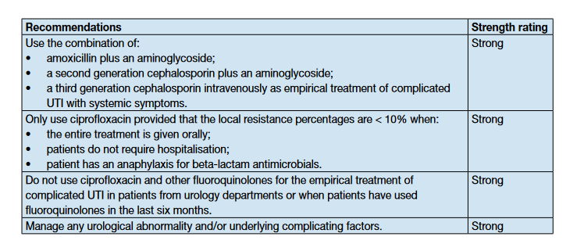

Slide 36

Catheter-associated UTIs
Catheter-associated UTI refers to UTIs occurring in a person whose urinary tract is currently catheterized
or has been catheterized within the past 48 hours
The urinary catheter literature is problematic as many published studies use the term CA-bacteriuria without providing information on what proportion are CA-ABU and CA-UTI, and some studies use the term CA-UTI when referring to CA-ABU or CA-bacteriuria

Slide 37
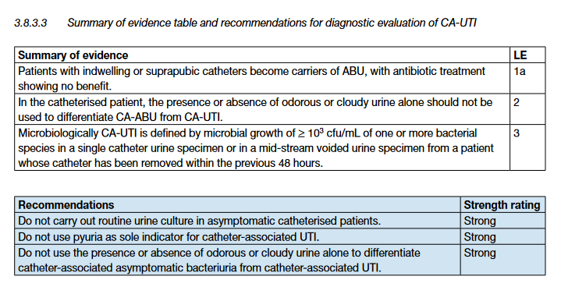


Slide 38
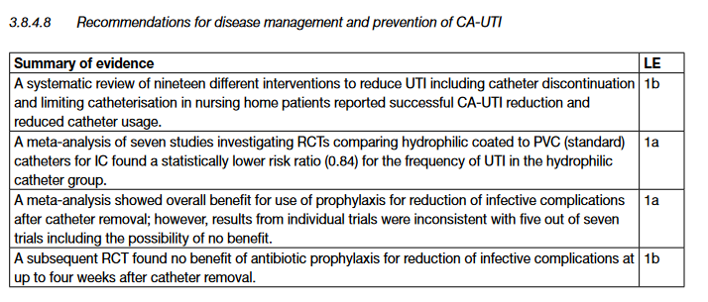


Slide 39
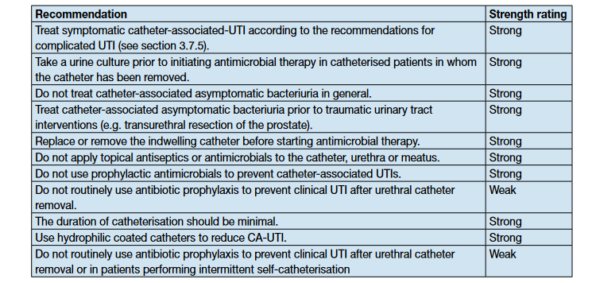

Slide 40
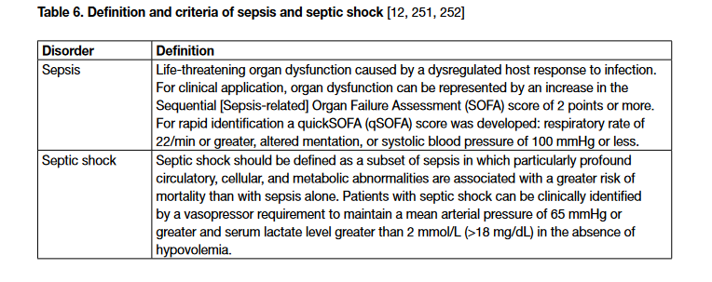
UROSEPSOS

Slide 41
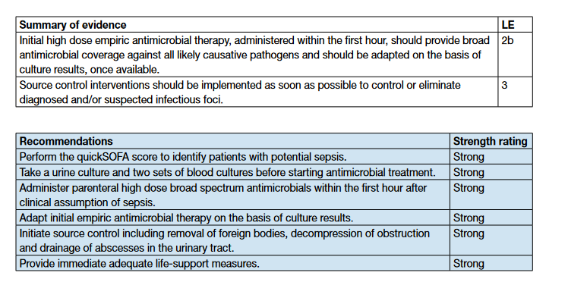

Slide 42
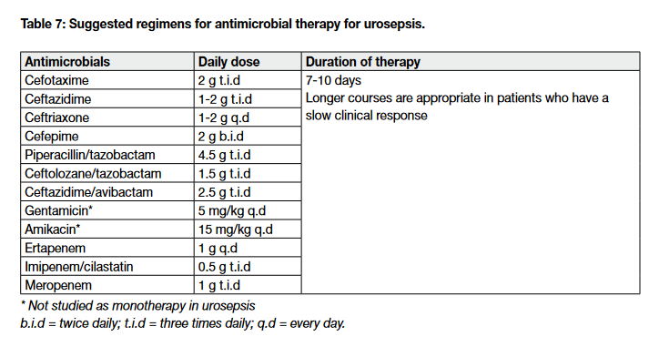


Slide 43

Finally we finished IT !!!

